Slide 1
WHY SO HARSH
-IMT2020548 Tejas Sharma
-IMT2020549 Dewanshi Dewan

Slide 2
Tasks performed
Understanding the domain of the problem statement i.e NLP
Initial analysis of data
Preprocessing of the data using the nltk library
Implementing a model (OneVsRestClassifier used with Logistic Regression)
Evaluation of the model

Slide 3
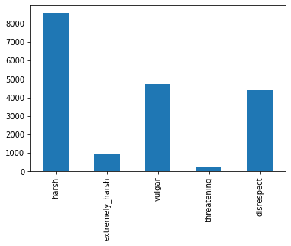
Initial Analysis
There are 89359 rows of comments and there are 6 flags for each comment.
NO NULL values
There is no duplicated data present
The graph to the right shows how many comments have been flagged under a particular category.
10% of the dataset is flagged as harsh. While the least is flagged as threatening.

Slide 4
Preprocessing of comments
Since we are working with raw textual data, we have to pre process it to get text which can be worked with. This is achieved by:
Tokenizing data
Removing stopwords
Removing punctuations
Lemmatizing text
Converting text to lowercase
Removed words of length <2
Removed URL tags

Slide 5
Implementing Model
With the pre processed text, we performed the following operations:
Convert text into a vector representing the count of occurrence of each word
Convert that vector by TF-IDF
Use that vector to fit the model
For the testing data, transform the data into the same occurrence count used in 1st point
Convert that vector by using TF-IDF and predict the values

Slide 6
Evaluation of the Model
On evaluating the above model we got the following results:
The AUC_ROC score for each column was around 0.68-0.7 in the test data formed from the test-train split
This suggests that the model is average at discriminating

Slide 7
Future plan
The main goal is to find a better model using neural networks.
Then the goal would be to improve our pre processing, check for better ways to fine tune the model for better results.

Slide 8
Contributions
Checking for duplicate values, null values, Distribution plot, Tokenization, Punctuation removal, Stopword removal, Implemented TF-IDF, Implemented the model
- done by Dewanshi Dewan
Input/Output split, Train-test split, Lemmatization, Implemented the model
- done by Tejas Sharma

